Slide 1
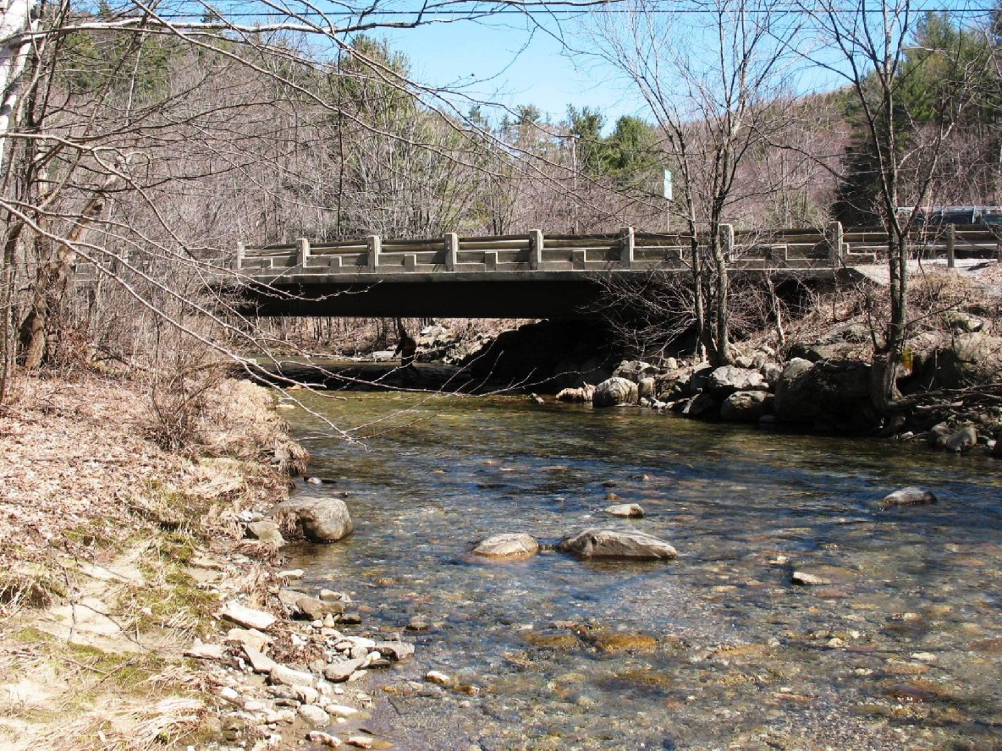
Bristol BF 021-1(33) Regional Concerns Meeting VT Route 116 – Bridge #12 over Baldwin Creek
April 27, 2015

Slide 2
Introductions
Jennifer Fitch, P.E.
VTrans Project Manager
Laura Stone, P.E.
VTrans Scoping Engineer
Carolyn Carlson, P.E.
VTrans Senior Project Manager

Slide 3
Purpose of Meeting
Provide an understanding of our approach to the project
Provide an overview of project constraints
Discuss alternatives that were considered
Provide an opportunity to ask questions and voice concerns
Foster support for the recommended alternative

Slide 4
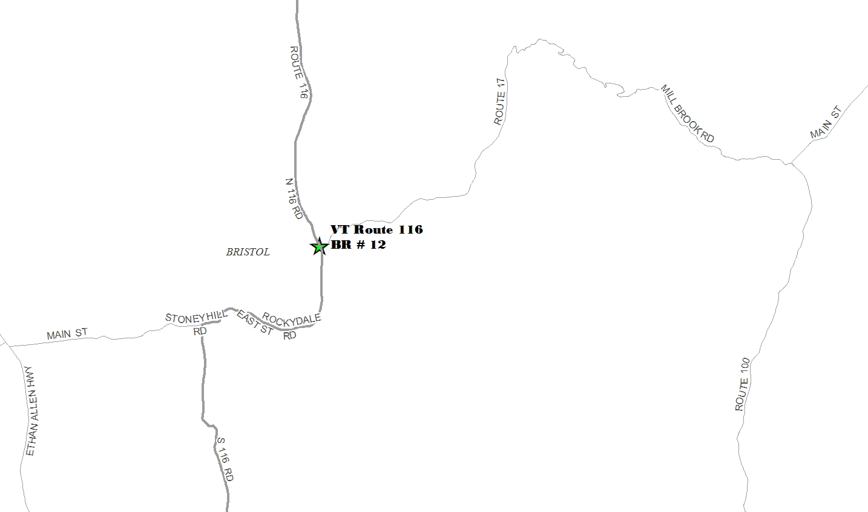
Location Map

Slide 5
Bridge 12
Project Location

Slide 6
Meeting Overview
VTrans Project Development Process
Project Overview
Existing Conditions
Alternatives Considered
Selected Alternative
Maintenance of Traffic
Schedule
Questions

Slide 7
VTrans Project Development Process
Initiated
Project
Funded
Project
Defined
Contract
Award
Project Definition
Project Design
Construction
Identify resources & constraints
Evaluate alternatives
Public participation
Build Consensus
Quantify areas of impact
Environmental permits
Develop plans, estimate and specifications
Right-of-Way Process (if needed)

Slide 8
Who are you representing?
Municipal Official
Resident
Emergency Services
Local Business
Independent Organization
Other

Slide 9
How often do you use this segment of VT Route 116?
Daily
Weekly
Monthly
Rarely
Never

Slide 10
How often do you walk over the bridge?
Daily
Weekly
Monthly
Rarely
Never

Slide 11
How often do you bike over the bridge?
Daily
Weekly
Monthly
Rarely
Never

Slide 12
What is your reason for attending this meeting?
Specific concern
General Interest
Live in close vicinity
Other

Slide 13
Project Overview
Existing Conditions
Alternatives Considered
Recommended Alternative

Slide 14
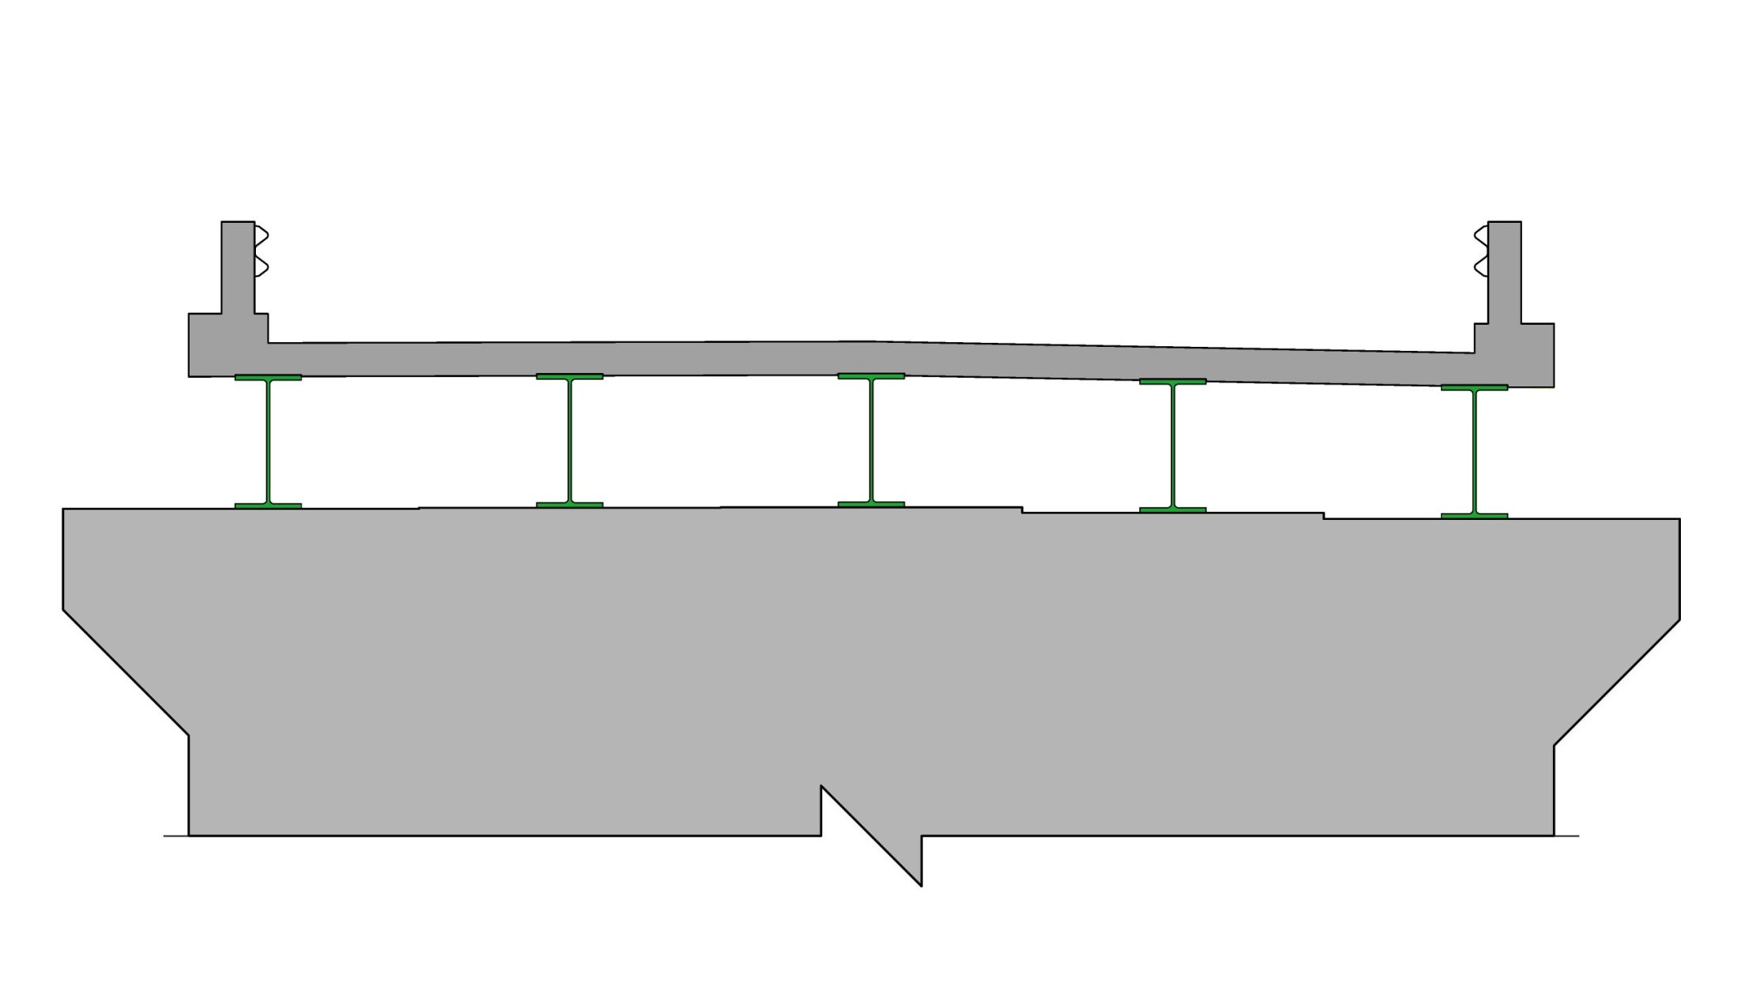
Description of Terms Used
Bridge Rail
Deck
Beams
(Superstructure)
Abutment
(Substructure)
Cross Section of Bridge

Slide 15
Existing Conditions – Bridge #12
Roadway Classification – Minor Rural Arterial
Superstructure – 89’ long Steel Beam Bridge
Substructure – Skeletal Abutments
Constructed in 1955
Ownership – State of Vermont

Slide 16
Existing Conditions – Bridge #12
The existing concrete deck is in poor condition. There have been pop-outs in the past, and future deck pop-outs are possible at any time.
Deck geometry is substandard.
The roadway is not banked sufficiently for the horizontal curve present.
Bridge railing is substandard.

Slide 17
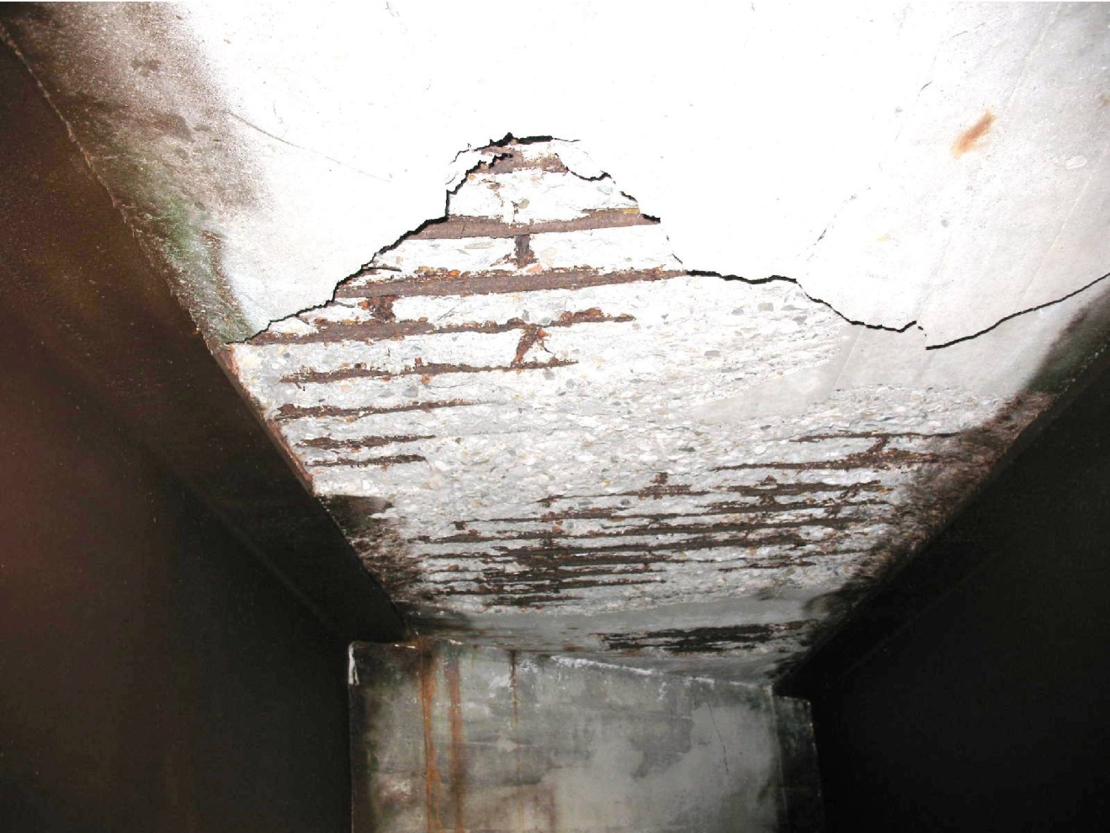
Existing Conditions - Bridge #12
Deck Rating 4 (Poor)
Superstructure Rating 7 (Good)
Substructure Rating 6 (Satisfactory)
Channel Rating 7 (Good)
Continual deck deterioration with large delaminations and exposed rebar

Slide 18
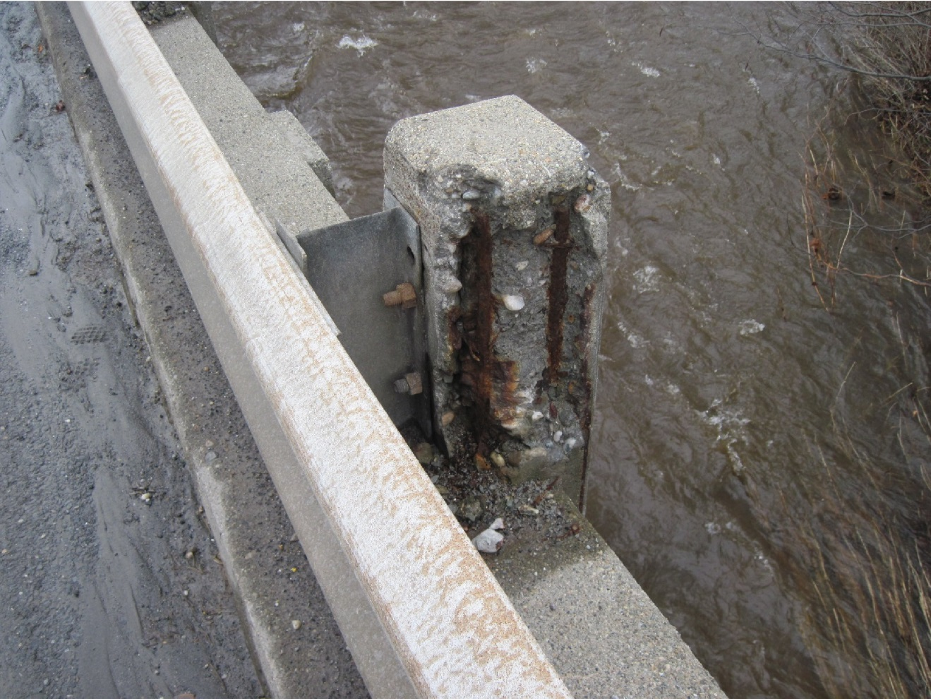
Existing Conditions - Bridge #12
Bridge Railing
Not Crash tested
Deteriorated posts, Exposed Reinforcing Steel
Bridge Railing

Slide 19
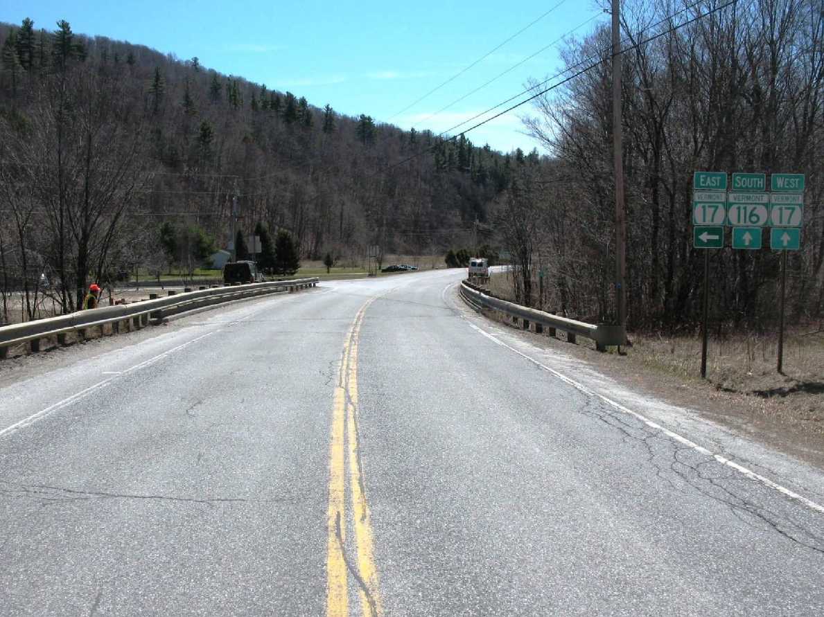
Looking South Over Bridge
Existing Conditions - Bridge #12
Substandard Horizontal Curve
Substandard Deck Geometry
Existing: 11’/4’
Standard: 11’/5’

Slide 20
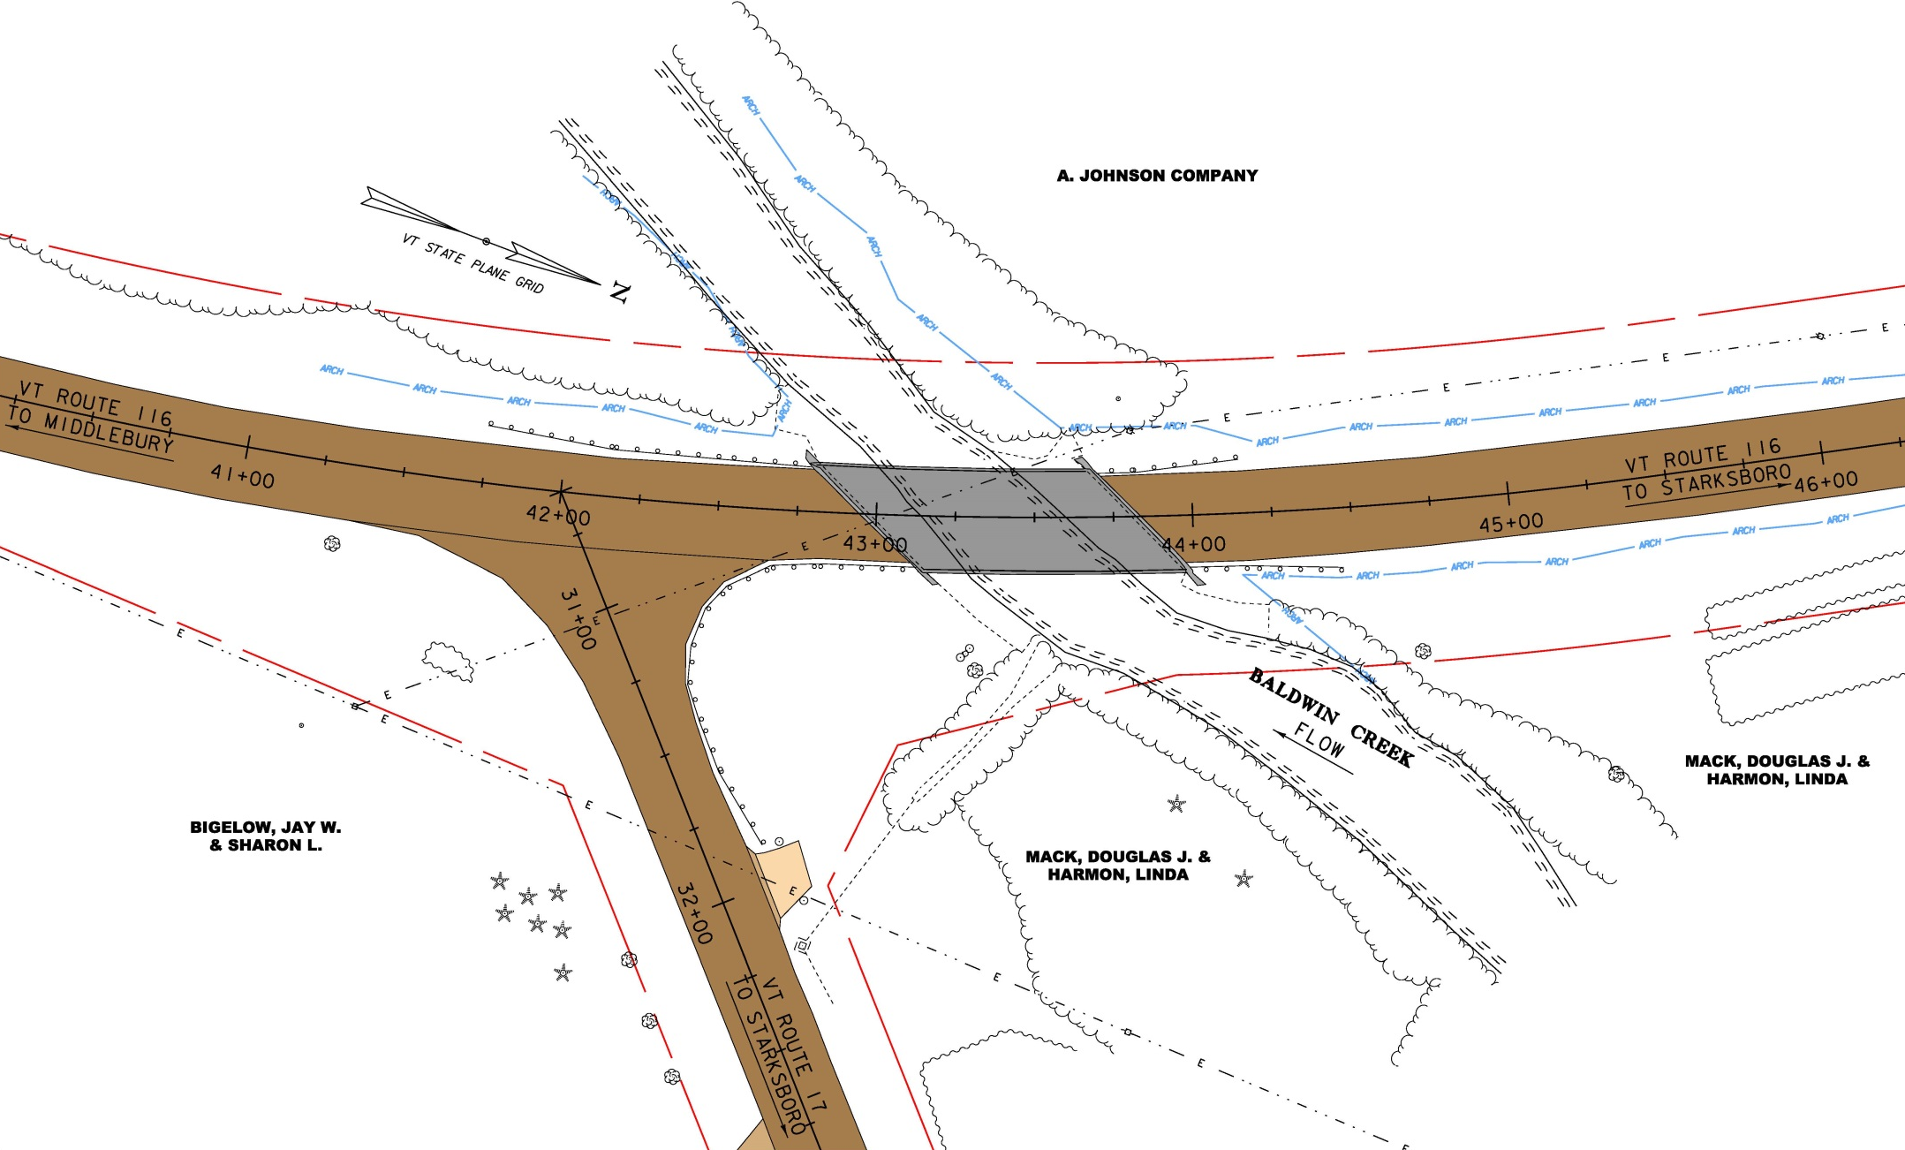
Existing Conditions

Slide 21
Design Criteria and Considerations
ADT of 2,800
DHV of 320
% Trucks: 15.7
Design Speed of 50 mph
Archaeological resources in 3 quadrants

Slide 22
Alternatives Considered – Bridge #12
No Action
Additional maintenance required within 10 years
Rehabilitation – Deck Patching
Deck and substructure patching with anodes
Shortest design life
Substandard width and railing
Rehabilitation – Deck Replacement
Longer lifespan compared to patching
Substructure patching with anodes
Width and railing brought up to standard
Full Bridge Replacement
Longest design life
Meets all geometric criteria

Slide 23
Selected Alternative - Bridge #12
Replace existing deck
Bridge widened by 1 foot on each side to meet standard
New approach railing and bridge railing
New joints
Meets all geometric criteria
40 year design life
Utility relocation will be needed
No ROW needed

Slide 24
Proposed Typical Sections
Proposed Bridge Rail to Rail = 32’ (Existing is 30’)

Slide 25
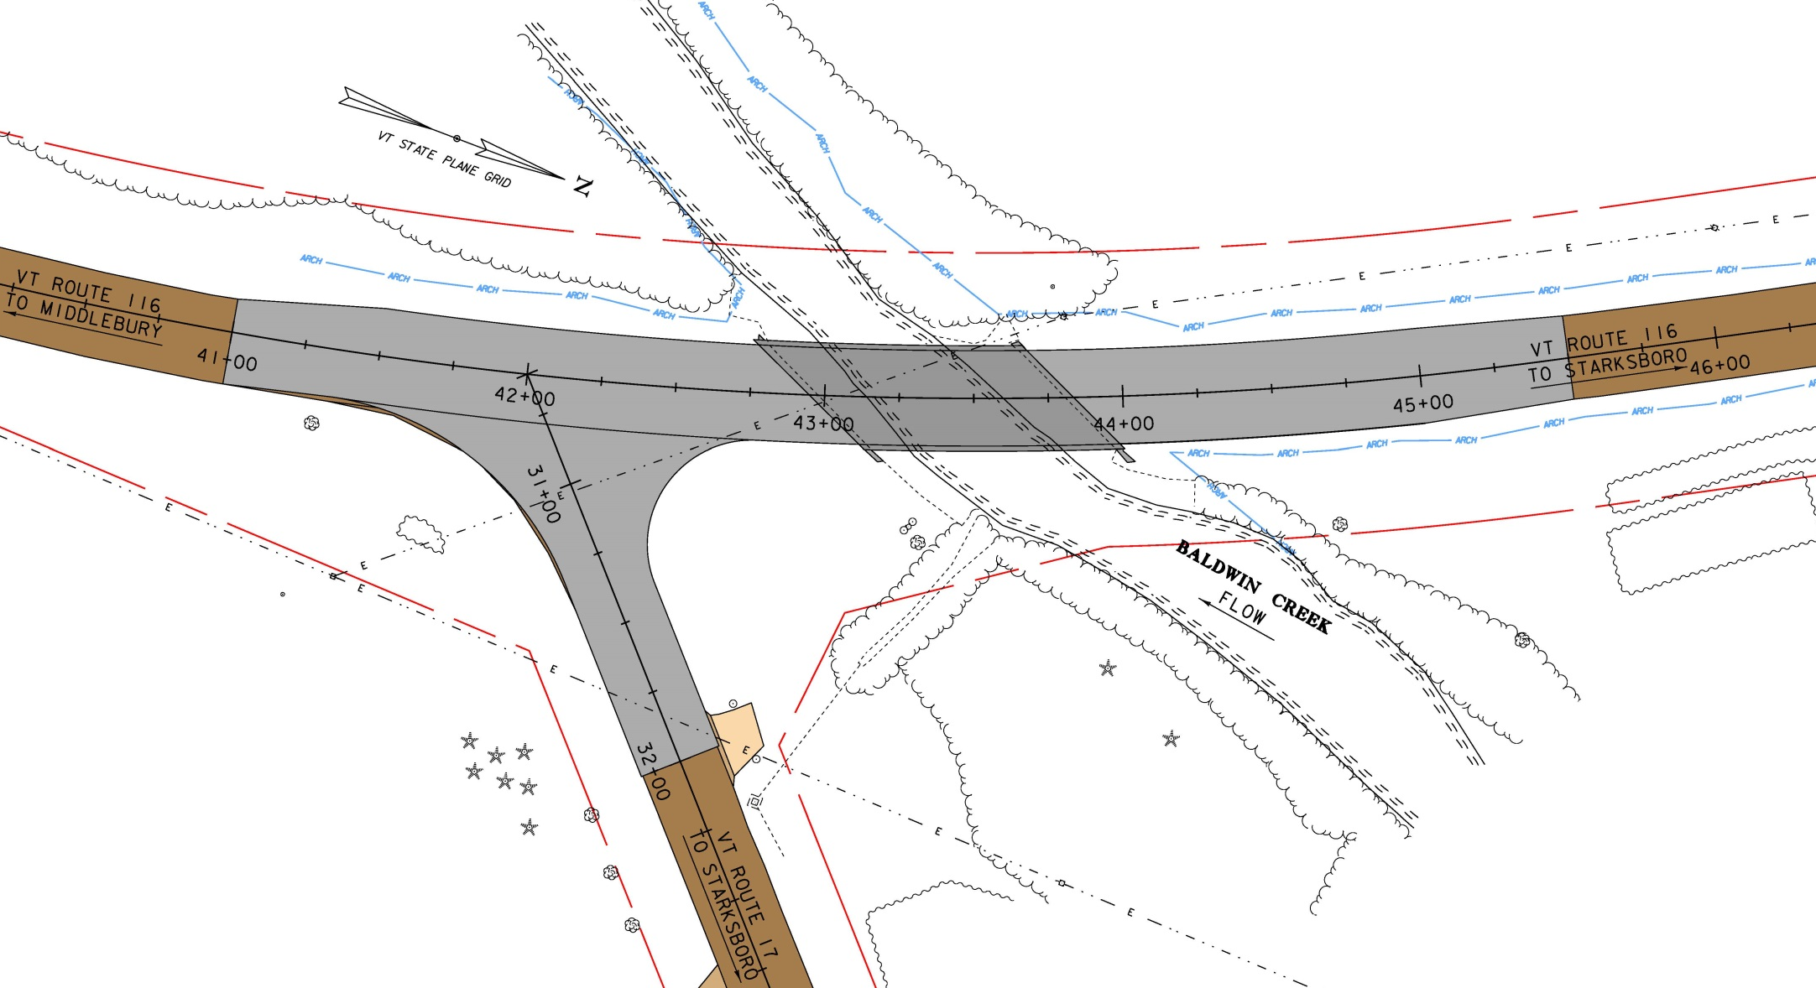
Proposed Layout

Slide 26
Maintenance of Traffic Options Considered
Road Closure with Offsite Detour
Signed by State, regional detour route: 61.3 miles end-to-end
Phased Construction
Minimal impacts to adjacent properties, wetlands, and wooded areas
Longer construction duration
No ROW needed
Temporary Bridge
One-way with signals, downstream
Biggest impacts to ROW, adjacent properties, and archaeological resources

Slide 27
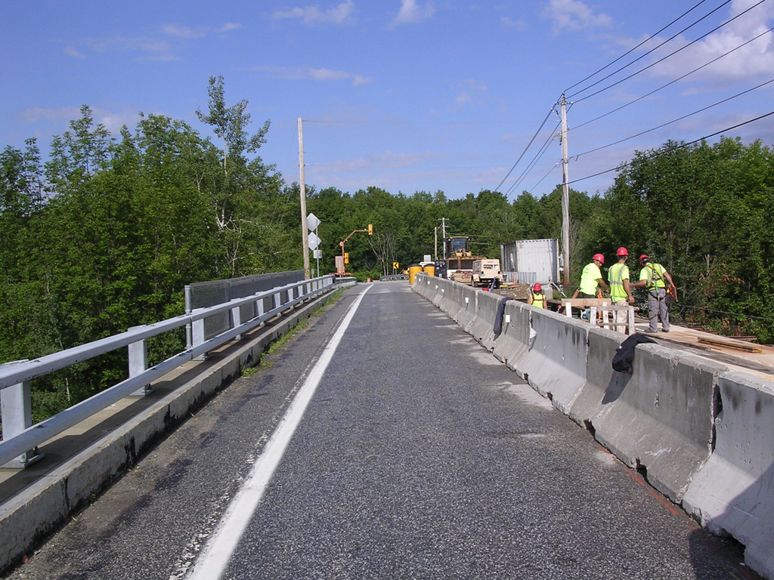
Selected Maintenance of Traffic
Phased Construction
One lane, alternating, with a traffic signal
Existing is wide enough to complete deck replacement with 2 phases
No ROW needed
(Picture from US Route 7 Bridge 184 in Highgate)

Slide 28
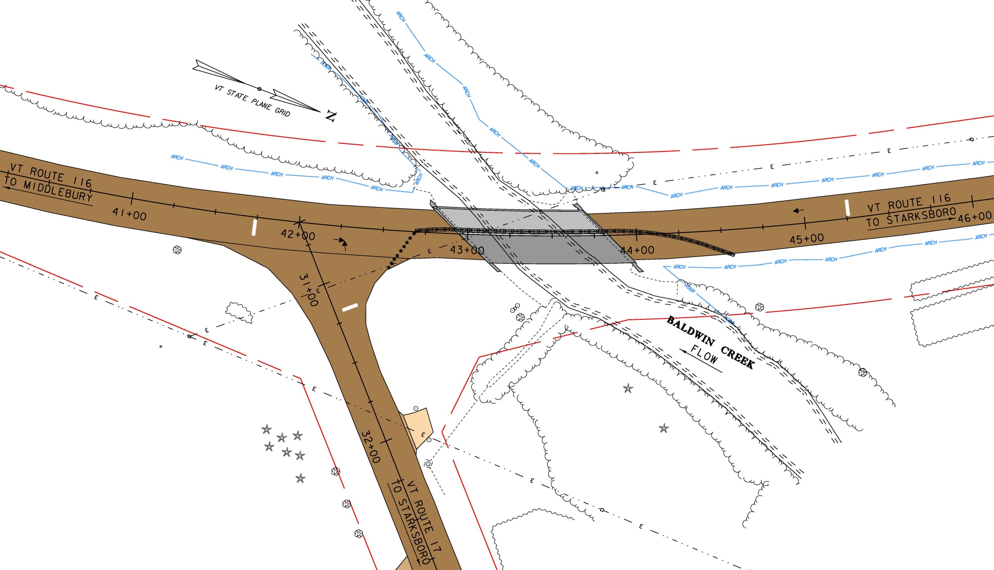
Phase 1 Layout

Slide 29
Phase 2 Layout

Slide 30
Which would you be most concerned about?
Construction delays on VT Route 116
Bridge Aesthetics
Environmental Impacts
Recreational Impacts
Other
Not really concerned

Slide 31
Which design aspect is the most important to you?
Shoulder width/bicycle accommodations
Aesthetics - Bridge Railing
Construction year
Construction Duration
Cost
Other

Slide 32
Preliminary Project Schedule
Construction – Summer 2017 or 2018

Slide 33
Project Summary
Replace deck:
Phased construction
2 Phases
Bearing replacement as necessary
Substructure concrete patching as necessary
Utility relocation will be needed
No ROW needed

Slide 34
Did you find this presentation to be?
Too technical in nature
Too simplified
Just about right
Not much use at all

Slide 35
Do you find the recommended scope of work satisfactory?
Yes
No

Slide 36
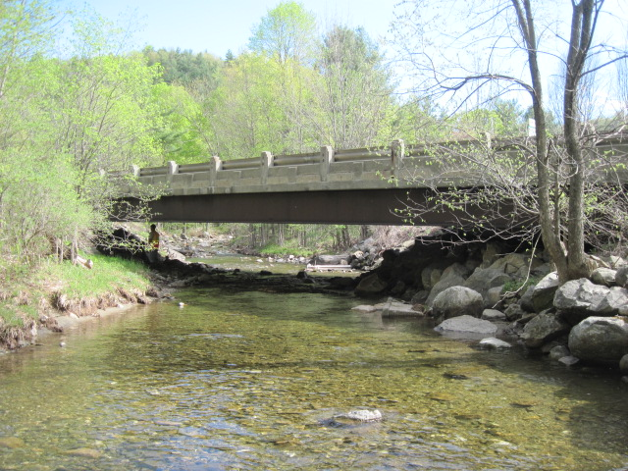
Bristol BF 021-1(33) Questions and Comments VT Route 116 – Bridge #12 over Baldwin Creek
For more information:
https://outside.vermont.gov/agency/vtrans/external/Projects/Structures/13B256
April 27, 2015

Slide 37
Alternatives Matrix
Bristol BF 021-1(33) | Alt 1 | Alt 2 |  | Alt 3
 | Deck Patching | Deck Replacement |  | Full Bridge Replacement
 | Short Term Lane Closures | a. Offsite Detour | b. Phasing | a. Offsite Detour | b. Phasing | c. Temporary Bridge
Total Project Costs (including Engineering and Contingencies) | $631,750 | $1,077,450 | $1,432,000 | $2,805,000 | $3,219,000 | $3,120,040
Project Development Duration | 2 years | 2 years | 2 years | 2 years | 2 years | 4 years
Construction Duration | 3 months | 3 months | 8 months | 6 months | 9 months | 18 months
Closure Duration (If Applicable) | N/A | 10 days | N/A | 4 weeks | N/A | N/A
Geometric Design Criteria | Substandard width | Meets Criteria | Meets Criteria | Meets Criteria | Meets Criteria | Meets Criteria
Alignment Change | No | No | No | No | No | No
Utilities | No Change | Possible Relocation | Possible Relocation | Relocation | Relocation | Relocation
ROW | No | No | No | No | No | Yes
Design Life | 15 Years | 40 years | 40 years | 80 years | 80 Years | 80 Years

Slide 38
Additional Considerations
None for this project

